Slide 1
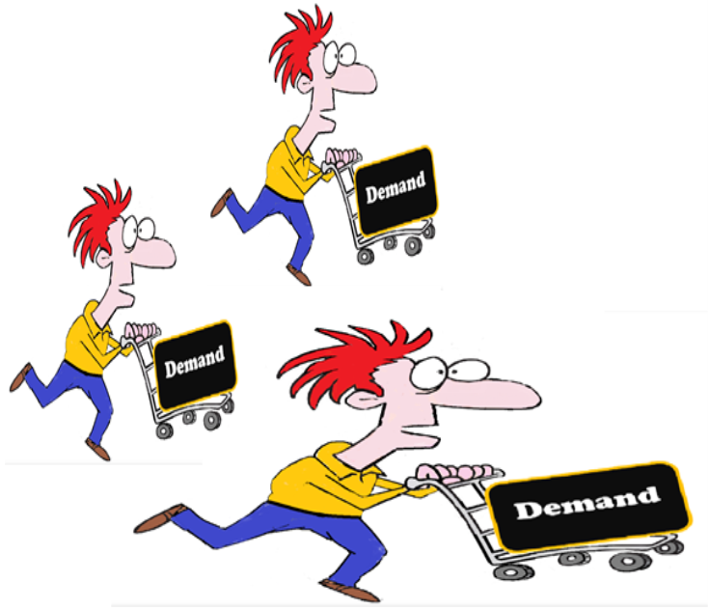


The Law of Demand
Important Factors that Change Demand
DEMAND CURVE SHIFT

Slide 2
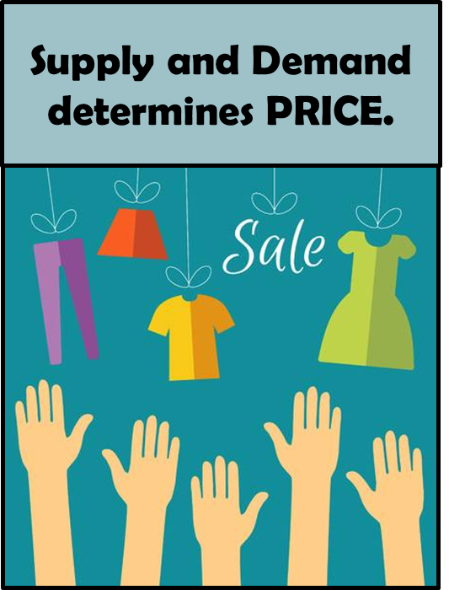
How is the price for a good or service determined?
A Combination of Supply and Demand
The Supply = How much is made available by the company (producer)
The Demand = How much is demanded by the consumer

Slide 3

What is DEMAND?
Demand = the amount of a good or service that consumers are willing to buy.

Slide 4

What is the Law of Demand?
The law of demand = says that consumers are willing to buy (demand) more of a good or service when prices go down.
= or consumers will buy (demand) less when prices increase.
Way is this True?: When a good becomes cheaper, people see it as a deal and will want or demand more of it.
The opposite is true when the price of something goes up; people see it as expensive and are less likely to buy it.
.

Slide 5
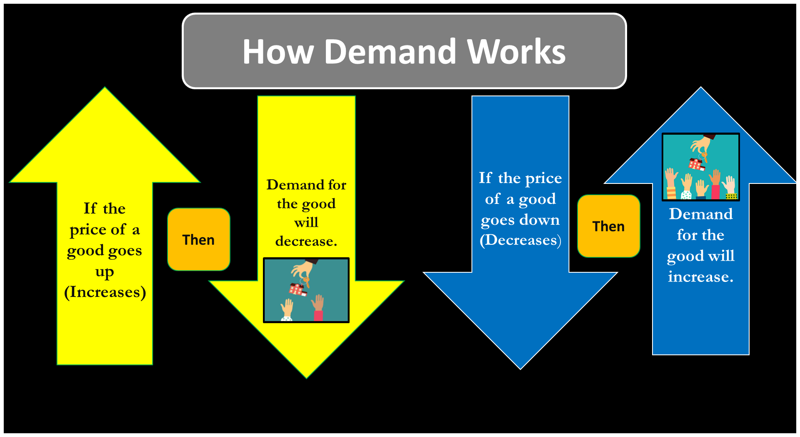

Slide 6

What does Demand Look Like on a Chart?
a. Demand can be shown on Demand Schedule Chart.
Demand Schedule for Ipads
Price for One Ipad | Demand for Ipads
If the price of an Ipad is $1000 | 5 people would demand it
$800 | 10
$600 | 15
$400 | 20

Slide 7
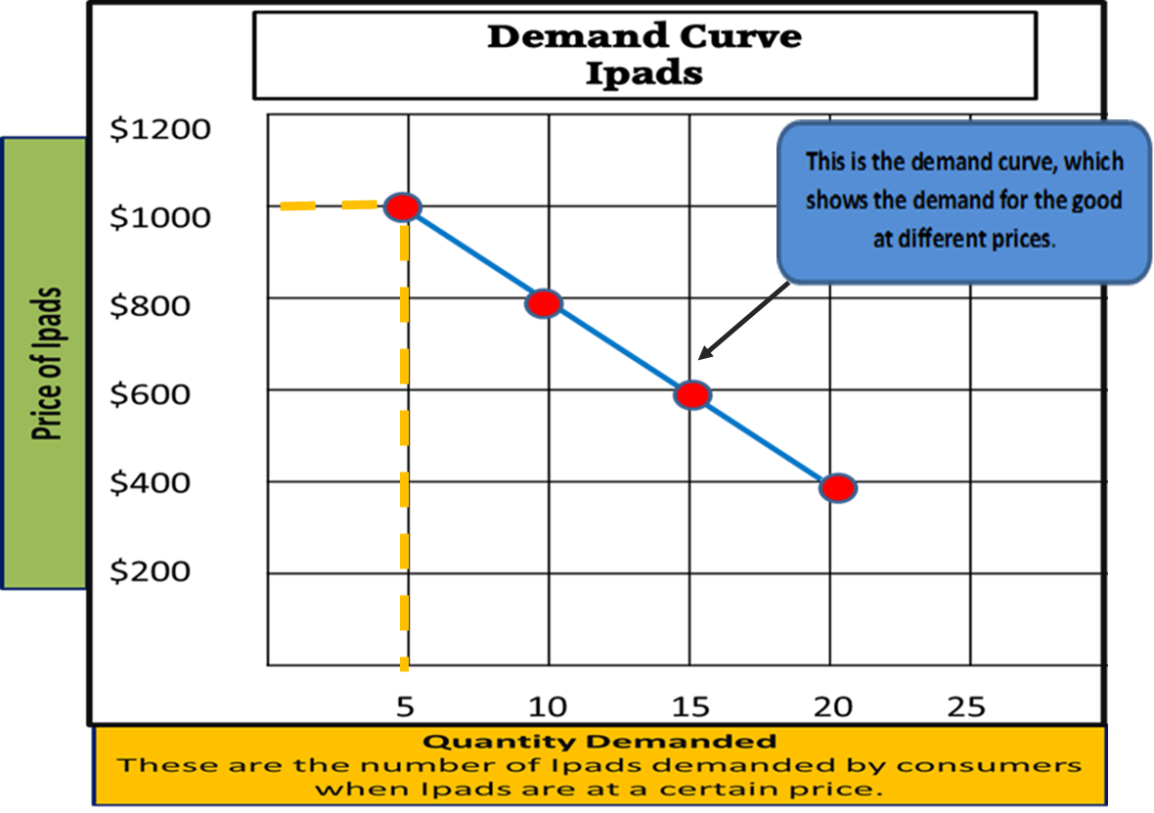
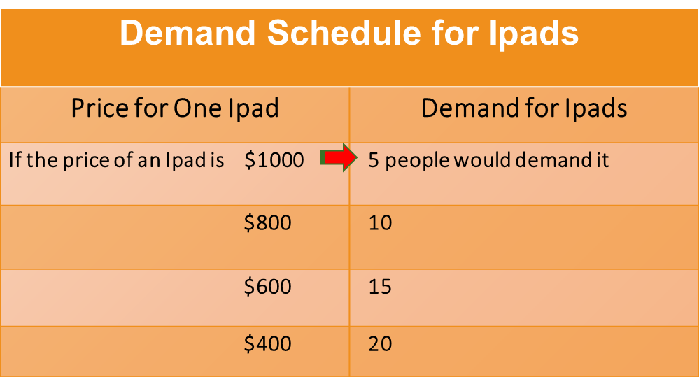
How can demand be shown on a graph?

Slide 8
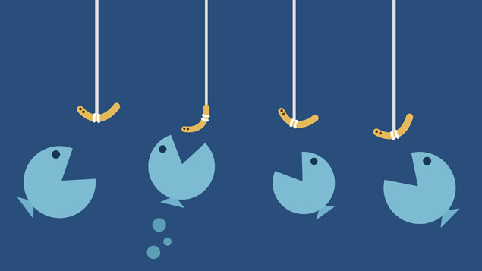
What are five factors that can change demand?
A. Besides price, others things can change the demand for goods.
C omplementary Goods
T astes
I ncome
P opulation
S ubstitute Goods

Slide 9

How does INCOME change demand?
The more money people make, the more goods they are able to buy.
A. Higher incomes lead to a increase demand.
B. Lower incomes cause a decrease in demand.

Slide 10
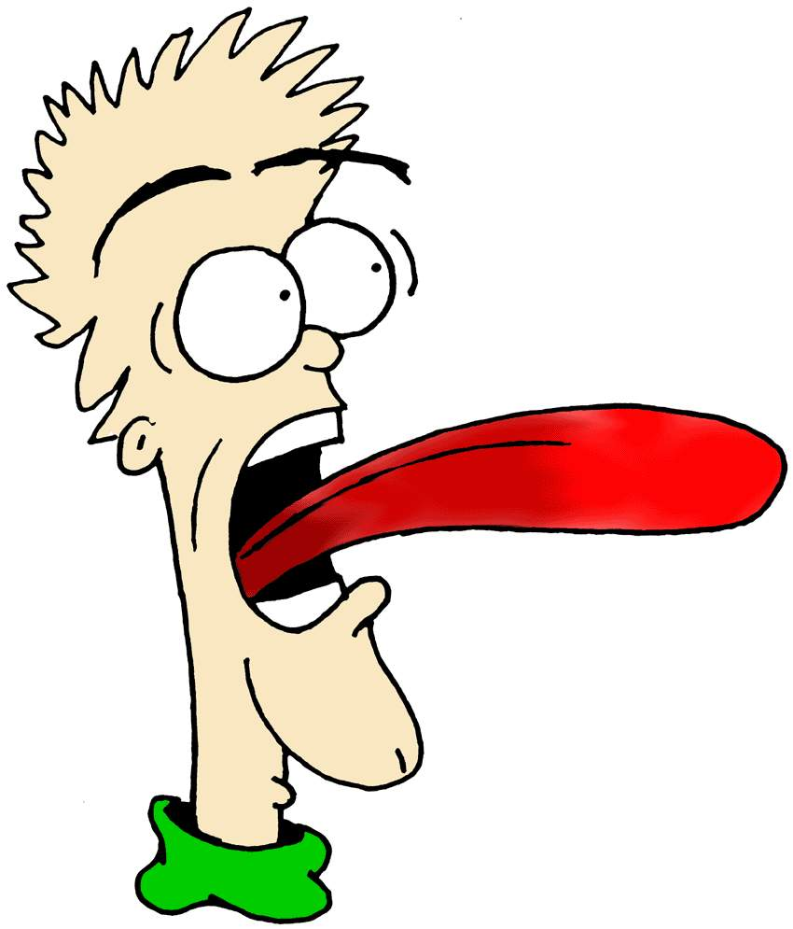
How does consumers’ taste change demand?
A. If a good is popular or considered fashionable then the demand for the good will increase.
B. If a good is unpopular or disliked there is a decrease in the demand for it.

Slide 11
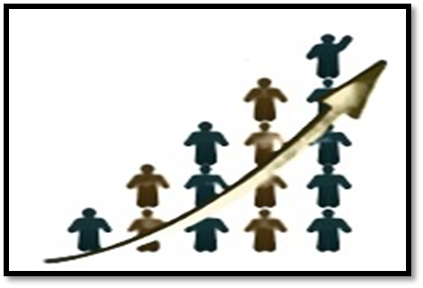
How does POPULATION change demand?
An increase in the number of people, means more people are able to buy a good.
a. Increase in population = Increase in demand.
b. Decrease in population = Decrease in demand.

Slide 12
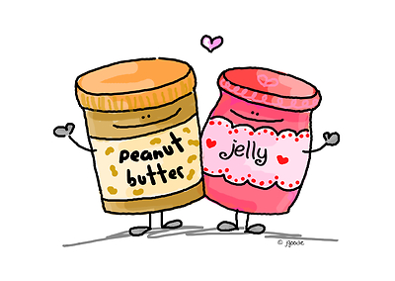
How does complementary goods change demand?
Complementary goods are goods that are used together.
For example; peanut butter is often used with jelly.
a. If the demand for peanut butter decreases for some reason, then the demand for jelly will also decrease
b. If the demand for peanut butter increases, then the demand for jelly will also increase.

Slide 13
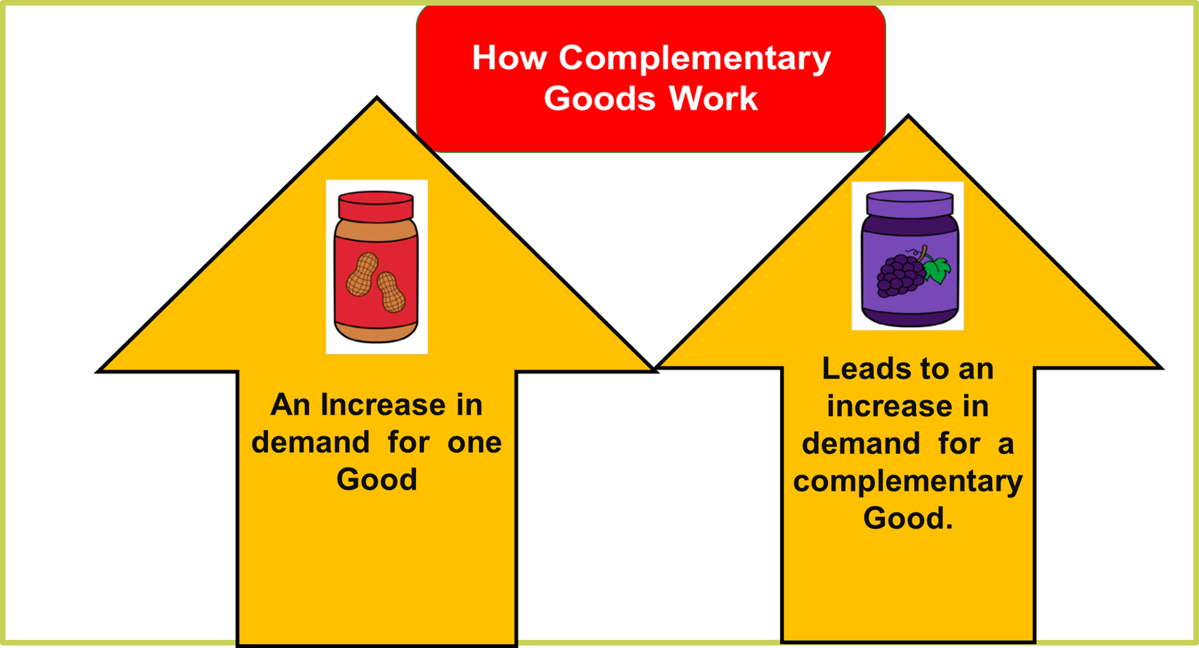

Slide 14
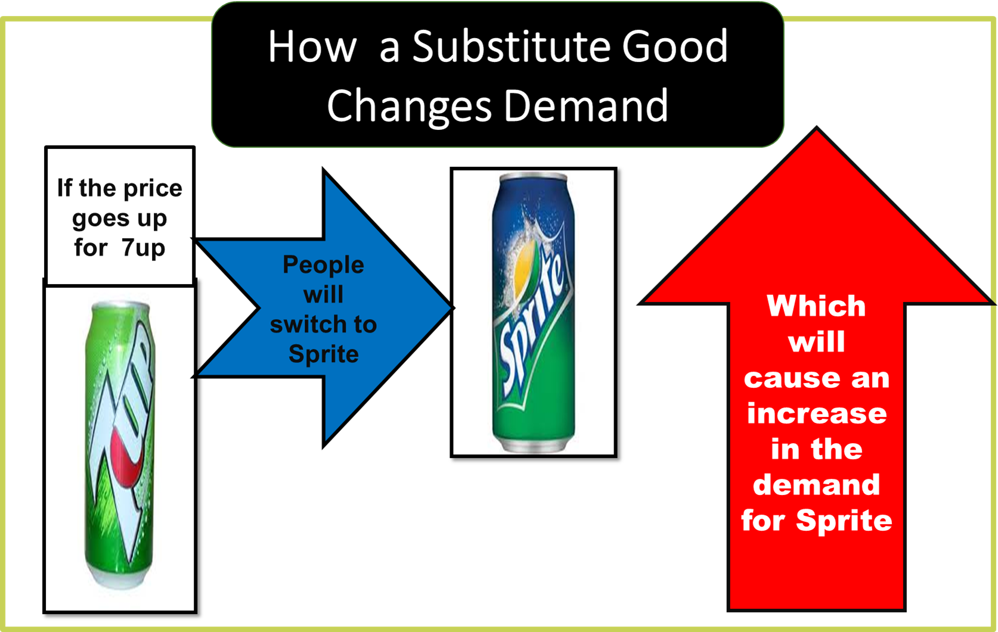
What is a SUBSTITUTE GOOD?
Substitute good = is a good that can take the place or be replaced for another good.
For example: If people want to, they can substitute the drink Sprite for a 7up.

Slide 15
What is a Demand Curve Shift?
The five (CTIPS) factors that change demand will cause the demand curve line in a graph to shift either to the right or left.
Left Shift = occurs when one of these factors decreases demand.
Right Shift = occurs when one of these factors increases demand.

Slide 16
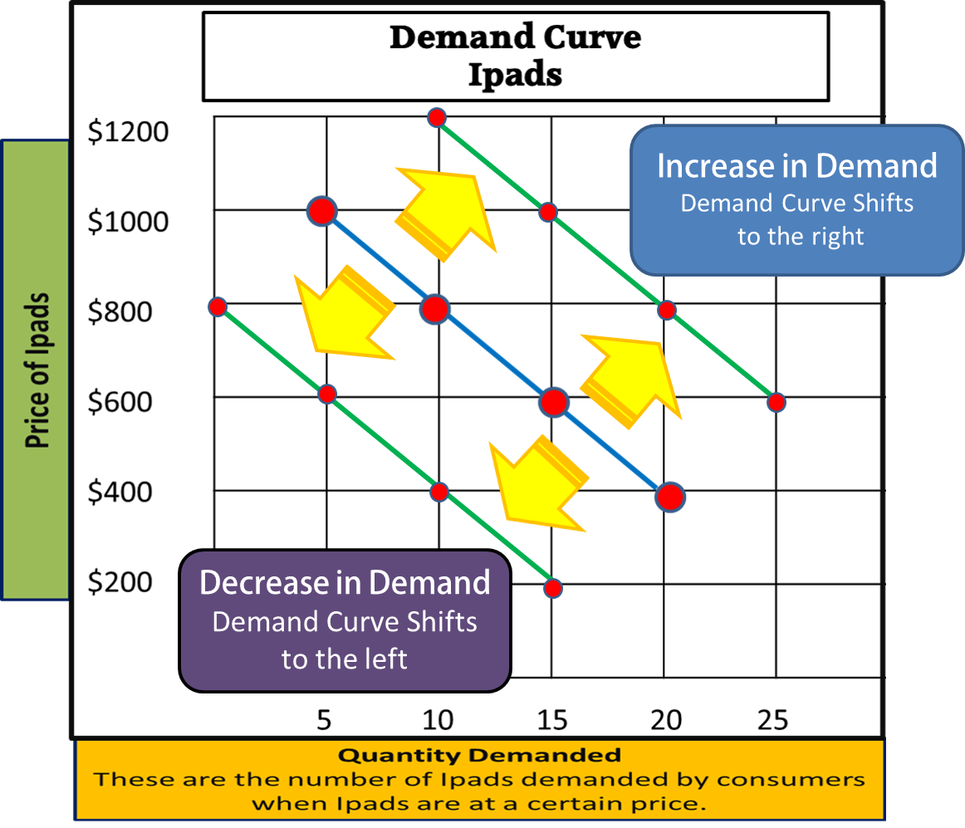
Demand Curve Shift
The shifts occurs from one of the five CTIPS factors.

